Slide 1
Visualizations in the News
Jala Rizeq
March 28, 2019
6135 Class Presentation

Slide 2
Infographics and Visualizations
“information graphic”
A graphic visual representation of information, data, or knowledge intended to clarify and integrate difficult information quickly and clearly
A new way to visualize data and ultimately communicate information
Computer-supported, interactive visual representations of data to amplify cognition – modern day inforraphic/visualization
Lankow, Ritchie, & Crooks; Siricharoen, 2013
Notes:
Infographic is an abbreviation of “information graphic

Slide 3
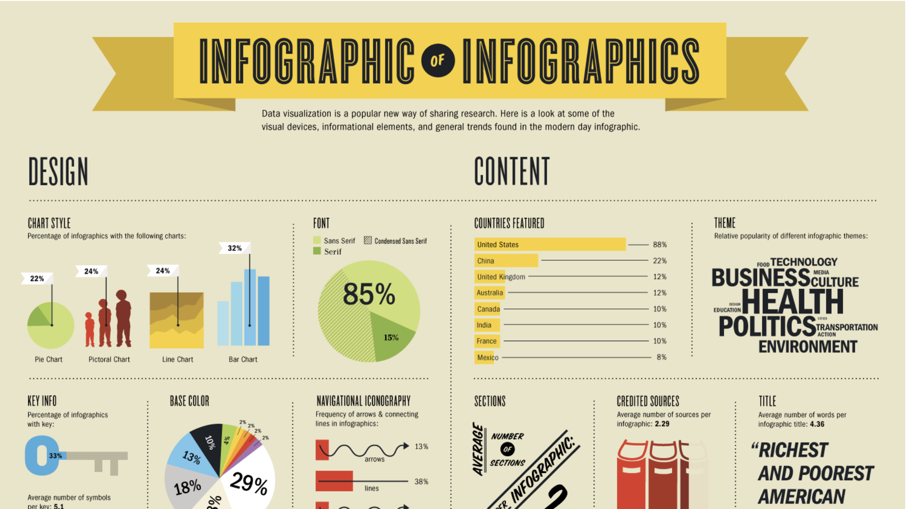

Slide 4
Elements of an Infographic or Visualization
Graphical Representation of Data
Charts | data is represented by symbols, including bars, lines, slices
Flowcharts | type of diagram that represents an algorithm or process, showing the steps as boxes and their order by connecting them with arrows
Diagrams | step-by-step solution to a given problem
Maps | representation of an area and depicting relationships between elements of that space
Mind maps | represents word ideas, tasks, or other items linked and arranged around a central key word or idea
Signs | visual orientation tools/signs
Typographic text | Written words
Ghode, 2012

Slide 5
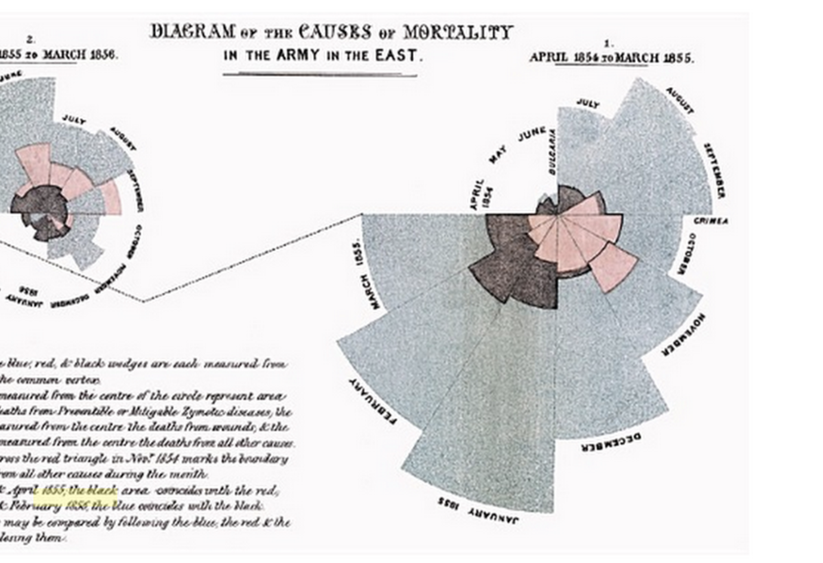
Early Infographics
Used as far back as the Victorian Era - Florence Nightingale showed the causes of mortality of the British Army during the Crimean War in the 1800s.
The infographic was presented to parliament, who had been unresponsive to health related concerns and hygiene issues experienced by the troops
It brought a new way of thinking about spread of disease
Lankow, Ritchie, & Crooks, 2013
Notes:
Each sector of the diagram represents a unique time period and represents a quantity.
She gathered data of death tolls and approached the job of communicating this information through applied statistics. She is particularly famous for the development and use of certain graphs, now commonly known as coxcombs or polar area plots, rose diagrams.Nightingale realised that soldiers were dying needlessly from malnutrition, poor sanitation, and lack of activity.

Slide 6
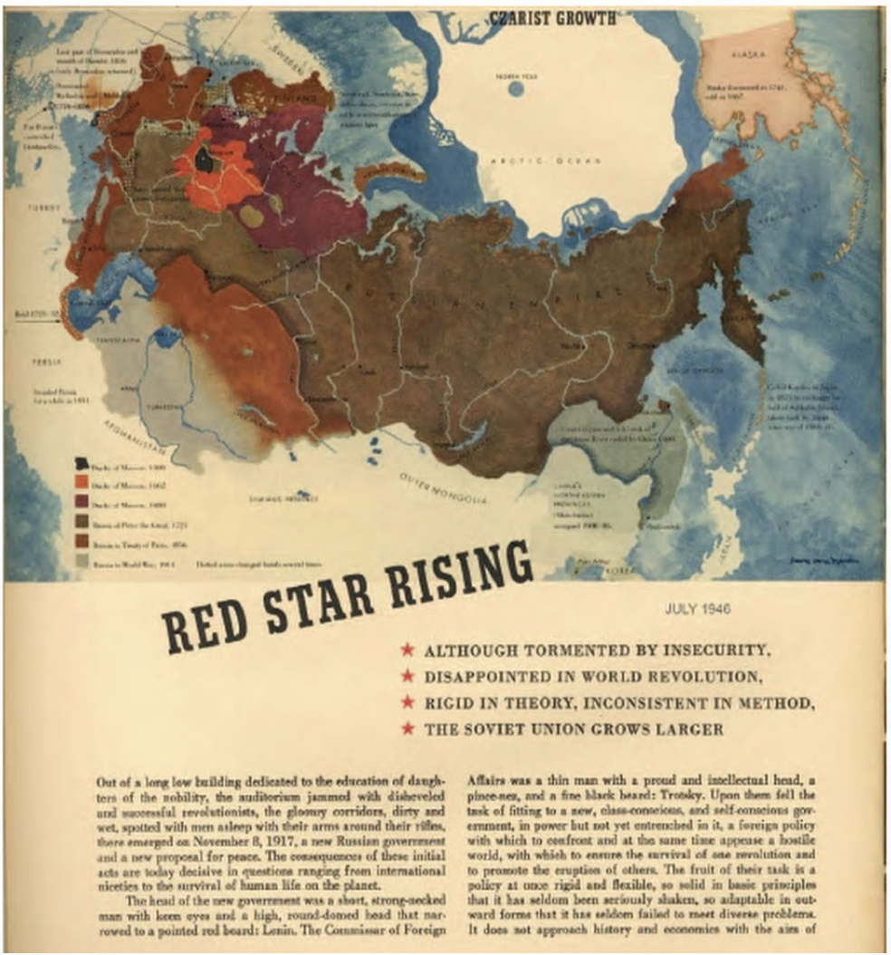
Early Infographics
Infographics were popularized in the 1930s and 1940s when Fortune magazine started using them.
The visualizations were considered an embodiment of true craftsmanship, characterized by iconic style and painstaking attention to detail
Lankow, Ritchie, & Crooks, 2013
Notes:
Design revolution in the newspaper with emergence of color in mid 1970s and informational graphics in 1980s

Slide 7
Age of data and information
We are constantly bombarded with information
People are more likely to skim than reflectively read full news articles
News stories are more credible when we can see the data

Slide 8
The purpose of infographics/visualizations
Includes the most amount of information with minimum space
Efficient and easy to understand
Tells a story
Attractive to the eye/reader – attention getter
Enables the integration of big data
Illustrates complex issues and events
Schroeder 2004; Smit, de Haan, and Buijs 2014

Slide 9
Infographics as an Upcoming Storytelling Genre
Unprecedented use of infographics in newspapers and online news media
Visualizations/infographics make it easier for journalists to communicate results from big data
New design software enables the production of more sophisticated visualizations
Designers, statistical analysts, and computing professionals are joining the news room
Dick 2014; Smit et al., 2014; Haan et al 2018; Giardina and Medina, 2013

Slide 10
Data Visualizations in the News
The Gaurdian has two interactive graphic teams
The BBC has a News Online Specials team
The Times has a Visual Journalism unit
Dick, 2014

Slide 11
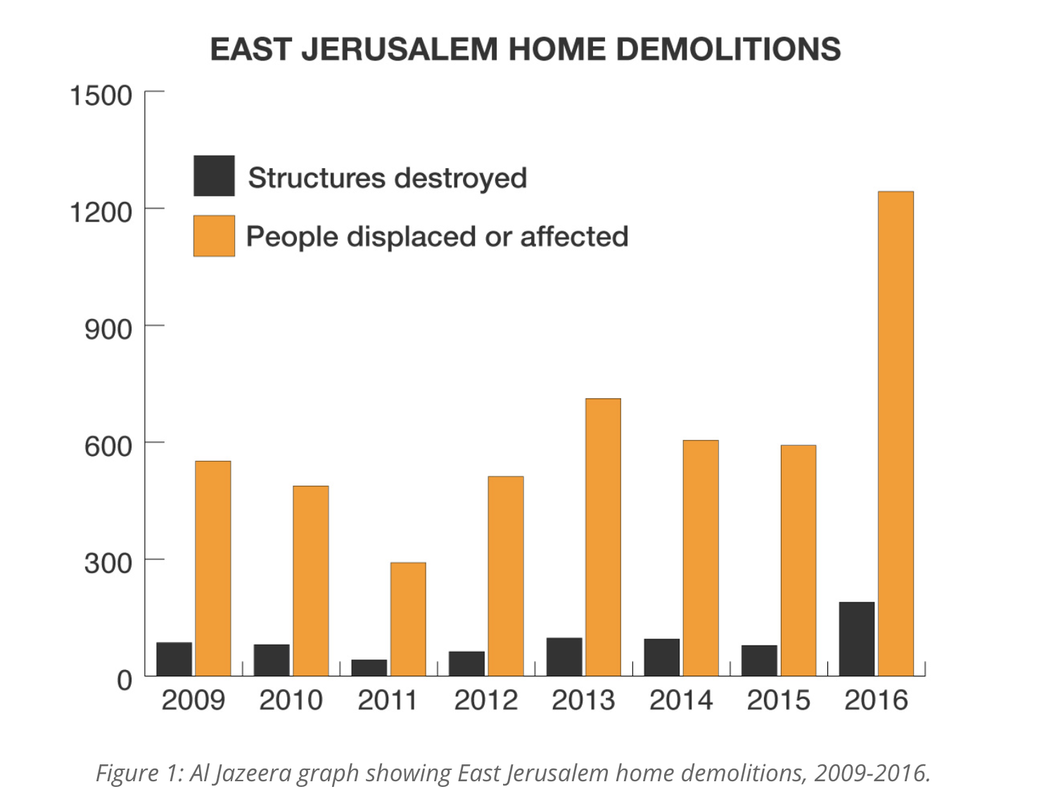
The Data Journalism Handbook 2
Tackling issues with data
Representing the data visually
This chart shows the number of structures destroyed and people affected by Israel’s policy of home demolitions.
Notes:
in East Jerusalem in 2016. It turned out to be a record year, with 190 structures destroyed and more than 1,200 Palestinians displaced or affected.

Slide 12
Data Visualizations and Infographics in the News
Al Jazeera – interactive https://interactive.aljazeera.com/aje/2018/the-cost-of-living-worldwide/index.html#/
BBC Future – Infographic section http://www.bbc.com/future/tags/infographic
New York Times labs http://nytlabs.com/projects/delta.html http://nytlabs.com/projects/streamtools.html

Slide 13
Venezuela’s Crisis in Numbers
https://www.aljazeera.com/indepth/interactive/2018/08/venezuela-crisis-numbers-180824123136718.html

Slide 14
Yemen: The Human Cost of War
https://www.aljazeera.com/indepth/interactive/2018/09/yemen-human-cost-war-180904105421830.html

Slide 15
The Question remains..
Are infographics/visualizations effective?

Slide 16
Haan et al. 2018
Empirically examined two relevant questions
1) Do news consumers see or use news data visualizations?
2) Under which conditions do news consumers appreciate news data visualizations?

Slide 17
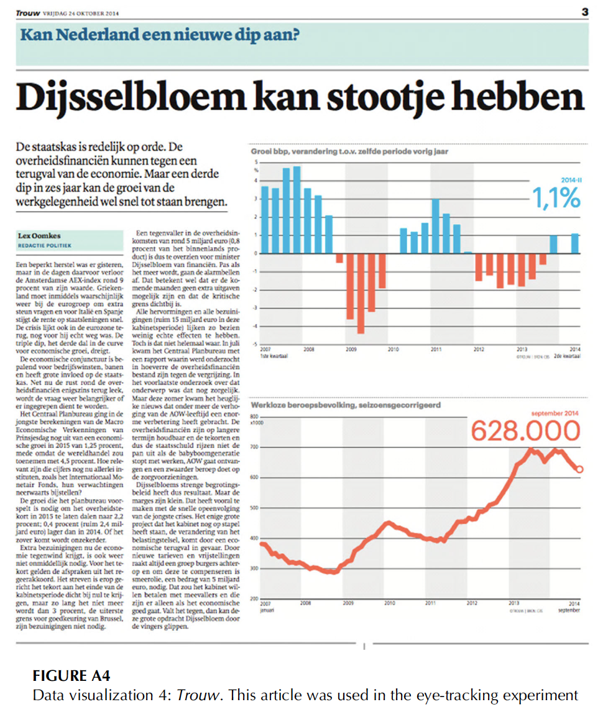
Study 1: to what extent Do news consumers see or use news data visualizations?
Eye-tracking method
Notes:
both visualizations included in the article (bar and line graph) were noticed (respectively, 95.9 and 89.3 per cent looked at both the
text and visualization). However, while the bar and line graphs were noticed, the dwell
time was significantly lower than for the text. On average, readers looked at the text
for 44.24 seconds, while the visualizations received only a limited amount of attention
from the readers (3.74 and 3.86 seconds, respectively
the dwell time is much lower compared to text, which indicates
that the visualization is used to obtain an overall impression and is not looked at in
detail. Furthermore, they did not find noticeable differences between modalities It seems that the platform (online vs paper) where the
news is published does not influence the use of both text and visual

Slide 18
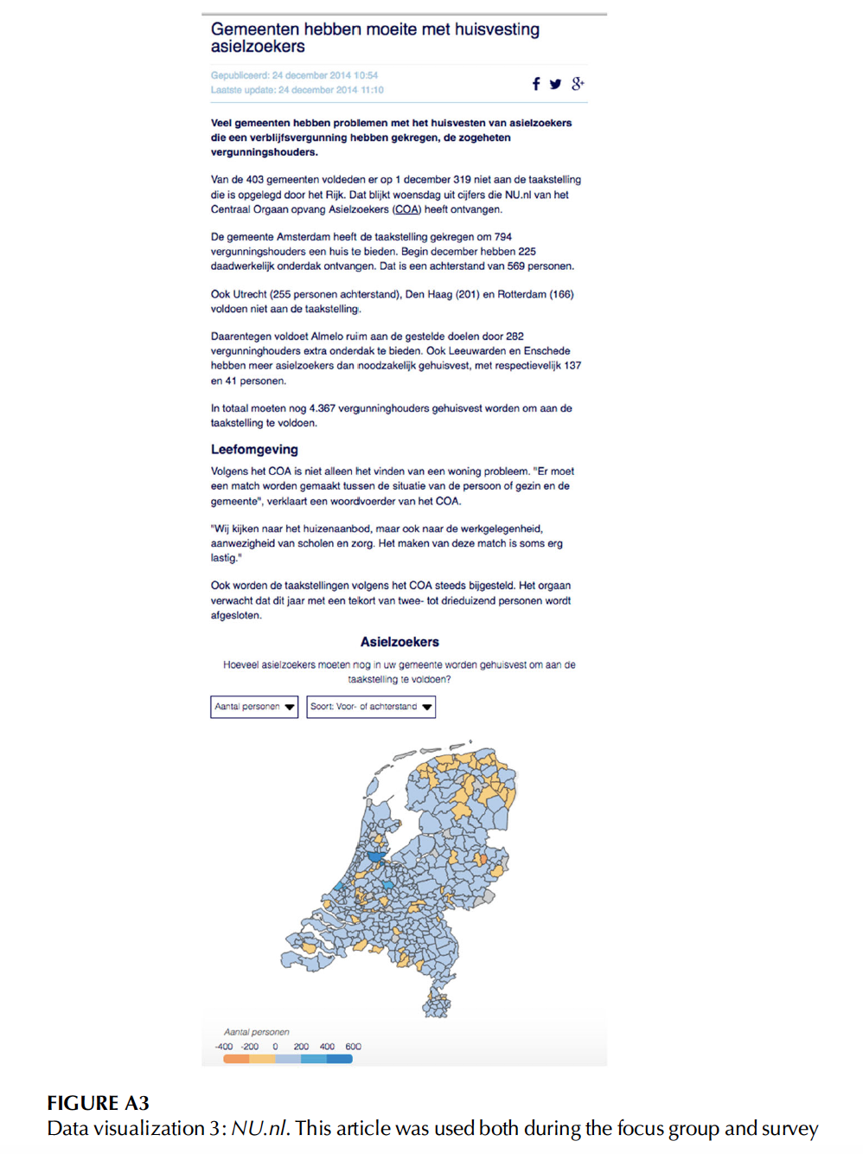
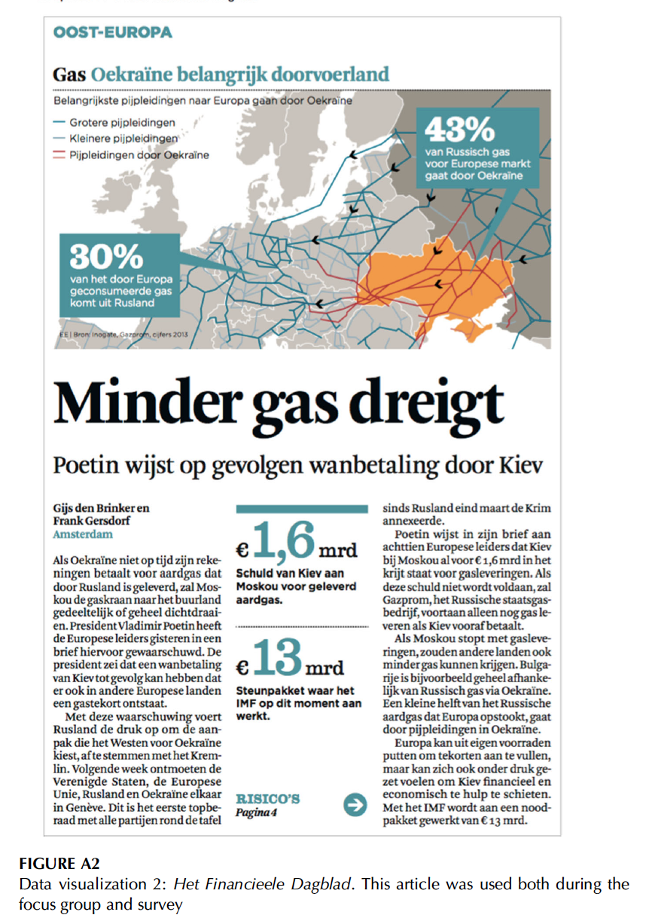
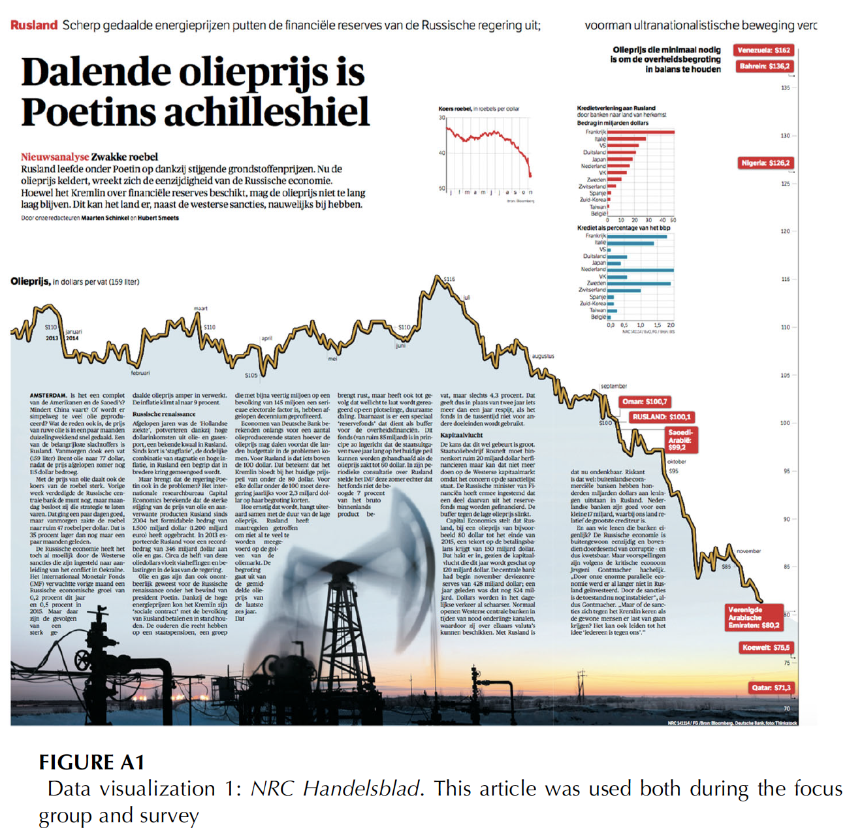
Study 2: Under which conditions do news consumers appreciate news data visualizations?
Focus group
Survey

Slide 19

Focus Group
The focus groups show that interest in a topic correlates positively with the decision to read the article with the visualization
Notes:
the intention to look at the visualization about politics (e.g., a visual about the Dutch
labor party) was positively correlated with participants’ perceived importance of politics
(r = 0.287, N = 105, p = 0.003). they also demonstrated that this perceived importance
of politics correlates with participants’ attitudes towards the visualization (e.g., they
believe the visual about politics is more beautiful and interesting, r = 0.371, N = 105,
p < 0.001 and r = 0.469, N = 105, p < 0.001, respectively).

Slide 20
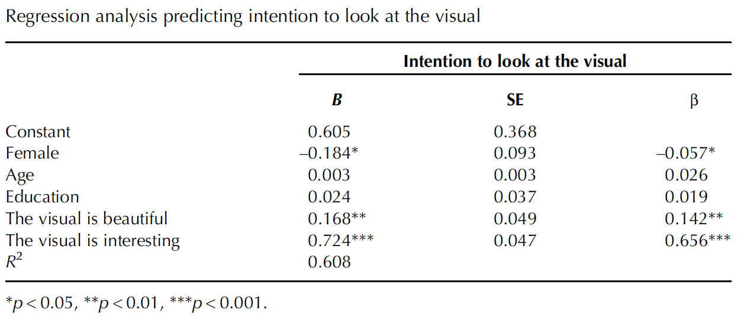
Survey Part I
Participants took a glance at the data visualization but did not read the article
They rated whether they would skip the visual or look at the visual (scale 1-7)
Measured first impression of the visual (ugly/beautiful and boring/interesting dimensions)
Notes:
When participants believe the data visualization is more beautiful and interesting, they are also more likely to
look at the visualization (see Table 4; r = 0.627, p < 0.001 and r = 0.771, p < 0.001,
respectively).
Aesthetics do play a role

Slide 21
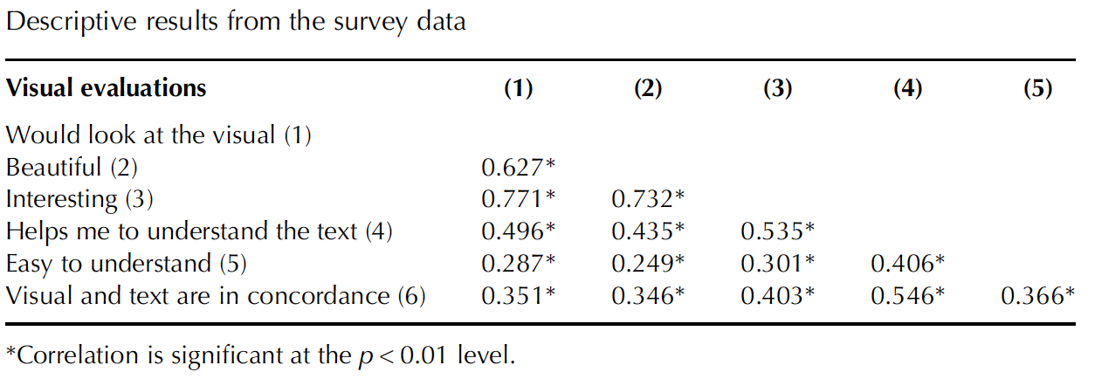
Survey Part II
Participants were now asked to read the article and look at the visual closely
Asked to rate the visuals and text on likert scales ranging from 1 to 7
Notes:
the function of the visualization influences the appreciation of the visualization. The survey shows that people
feel they understand the text and visual better when the visual and text are also in accordance
with each other

Slide 22
The Future of Visualizations in the News
An integrated view of design and journalistic content within newsrooms remains crucial.
Future research should tap into more advanced forms of visualizations, including interactive possibilities and other engaging facilities.
Some research is examining the effect of tablets on news consumption and the role of interactive visualizations.

Slide 23
Delta: Visualizing Reader Activity in Real Time
http://nytlabs.com/projects/delta.html

Slide 24
Thank you!

